Slide 1
34th Annual Report on Liver and Intestinal Transplantation Activity in Australia and New Zealand Data to 31 December 2022

Slide 2
Section 5. Liver Transplant Waiting List

Slide 3
Liver transplant waiting list activity – all patients
Notes:
Figure 1. Liver transplant waiting list activity – all patients

Slide 4
Paediatric liver transplant waiting list activity
Notes:
Figure 2. Paediatric liver transplant waiting list activity

Slide 5
Adult liver transplant waiting list activity
Notes:
Figure 3. Adult liver transplant waiting list activity

Slide 6
Time on waiting list by year of delisting
Notes:
Figure 4. Time on waiting list by year of delisting

Slide 7
Urgent category 1 waiting list outcomes
Notes:
Figure 5. Urgent category 1 waiting list outcomes

Slide 8
Urgent category 2 waiting list outcomes
Notes:
Figure 6. Urgent category 2 waiting list outcomes

Slide 9
Section 6. Deceased Liver Donors

Slide 10
Deceased donors and grafts transplanted by year
Notes:
Figure 7. Deceased donors and grafts transplanted by year

Slide 11
Transplants utilising machine perfusion with donor source type
Notes:
Figure 8. Transplants utilising machine perfusion with donor source type

Slide 12
Transplants with donor source type and use of machine perfusion
 | Donation after circulatory death |  |  |  | Donation after Brain Death
Transplant Year | DCD NMP | DCD HOPE | DCD no MP | DCD Total | % DCD with MP | DBD NMP | DBD HOPE | DBD no MP | DBD Total | % DBD with MP
2016 | 0 | 0 | 17 | 17 | 0.0% | 0 | 0 | 350 | 350 | 0.0%
2017 | 0 | 0 | 11 | 11 | 0.0% | 0 | 0 | 321 | 321 | 0.0%
2018 | 3 | 0 | 18 | 21 | 14.3% | 0 | 0 | 346 | 346 | 0.0%
2019 | 2 | 0 | 22 | 24 | 8.3% | 6 | 0 | 333 | 339 | 1.8%
2020 | 14 | 0 | 25 | 39 | 35.9% | 4 | 0 | 285 | 289 | 1.4%
2021 | 6 | 0 | 12 | 18 | 33.3% | 3 | 0 | 283 | 286 | 1.0%
2022 | 6 | 1 | 14 | 21 | 33.3% | 3 | 2 | 287 | 292 | 1.7%
Abbreviations: DCD, donation after circulatory death; DBD, donation after brain death; NMP, normothermic machine perfusion; HOPE, hypothermic oxygenated perfusion; MP, machine perfusion
Notes:
Table 1. Transplants with donor source type and use of machine perfusion

Slide 13
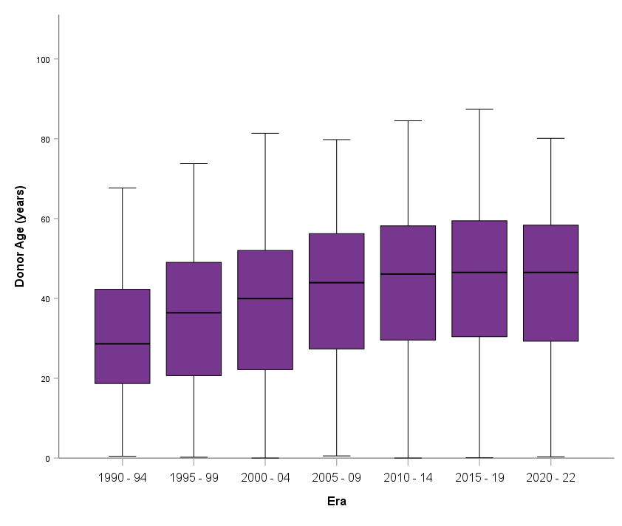
Median age of deceased donors by transplant era
Notes:
Figure 9. Median age of deceased donors by transplant era

Slide 14
Deceased donor age by transplant era
Notes:
Figure 10. Deceased donor age by transplant era

Slide 15
Section 7. Living Liver Donors

Slide 16
Living liver donor demographics
Living Donors | Paediatric Recipient (<16 years) | Adult Recipient (³16 years) | All Recipients
Number of living donors % living donors | 98 81.7% | 22 18.3% | 120
Gender of living donor
Female (% age category) | 46 (46.9%) | 8 (36.4%) | 54 (45.0%)
Male (% age category) | 52 (53.1%) | 14 (63.6%) | 66 (55.0%)
Age of living donor (years)
Median | 34 | 33 | 33
Range | 19 – 54 | 18 – 63 | 18 – 63
Living donor relationship
Father | 41 | 1 | 42
Mother | 25 | 0 | 25
Aunt | 11 | 0 | 11
Family friend | 8 | 1 | 9
Brother | 2 | 3 | 5
Domino whole liver | 0 | 5 | 5
Son | 0 | 5 | 5
Cousin | 4 | 0 | 4
Sister | 0 | 3 | 3
Uncle | 3 | 0 | 3
Daughter | 0 | 2 | 2
Grandmother | 2 | 0 | 2
Grandfather | 1 | 0 | 1
Half sister | 0 | 1 | 1
Husband | 0 | 1 | 1
Second cousin | 1 | 0 | 1
Notes:
Table 2. Living liver donor demographics

Slide 17
Section 8. Liver Transplantation in 2022

Slide 18
Patient demographics by age group (2022)
Patients Transplanted in ANZ in 2022 | Children (<16 years) | Adults (>=16 years) | Total Patients
Number of patients (% total patients) | 42 (13.7%) | 264 (86.3%) | 306
Sex
Female (% age category) | 23 (54.8%) | 92 (34.8%) | 115 (37.6%)
Male (% age category) | 19 (45.2%) | 172 (65.2%) | 191 (62. %)
Age at first ANZ transplant in 2022
Mean ± SD (years) | 5 ± 5 | 54 ± 11 | 47 ± 20
Median (years) | 1 | 57 | 54
Range | 10 d - 15 y | 18y - 75 y | 10 d - 75 y
Interquartile range | 8 m - 9 y | 47 y - 63 y | 39 y - 62 y
Status of patients at 31/12/2022
Alive (% age category) | 41 (97.6%) | 250 (94.7%) | 291 (95.1%)
Deceased (% age category) | 1 (2.4%) | 14 (5.3%) | 15 (4.9%)
Notes:
Table 3. Patient demographics by age group (2022)

Slide 19
Section 9. Liver Transplantation from 1985 – 2022

Slide 20
Cumulative number of liver transplants and new patients transplanted
Notes:
Figure 11. Cumulative number of liver transplants and new patients transplanted

Slide 21
Liver transplant rate and total Australia and New Zealand population
Notes:
Figure 12. Liver transplant rate and total Australia and New Zealand population

Slide 22
Patient demographics by age group (1985 – 2022)
Patients Transplanted in ANZ from 1985 to 2022 | Children (<16 years) | Adults (>=16 years) | Total Patients
Number of patients (% total patients) | 1,132 (16.2%) | 5857 (83.8%) | 6,989
Sex
Female (% age category) | 580 (51.2%) | 1,973 (33.7%) | 2,553 (36.5%)
Male (% age category) | 552 (48.8%) | 3,884 (66.3%) | 4,436 (63.5%)
Age at first ANZ transplant
Mean ± SD (years) | 4 ± 4 | 50 ± 11 | 43 ± 20
Median (years) | 2 | 53 | 50
Range | 10 d - 15 y | 16 y - 75 y | 10 d - 75 y
Interquartile range | 10 m - 7 y | 44 y - 59 y | 33 y - 58 y
Status of patient
Alive (% age category) | 939 (83.0%) | 3,862 (65.9%) | 4,801 (68.7%)
Deceased (% age category) | 193 (17.0%) | 1,995 (34.1%) | 2,188 (31.3%)
Notes:
Table 4. Patient demographics by age group (1985 – 2022)

Slide 23
Number of patients transplanted by age group by year of first transplant
Notes:
Figure 13. Number of patients transplanted by age group by year of first transplant

Slide 24
Recipient age strata at first Australian or New Zealand transplant (1985 – 2022)
Notes:
Figure 14. Recipient age strata at first Australian or New Zealand transplant (1985 – 2022)

Slide 25
Recipient age strata (percentages) by transplant era
Notes:
Figure 15. Recipient age strata (percentages) by transplant era

Slide 26
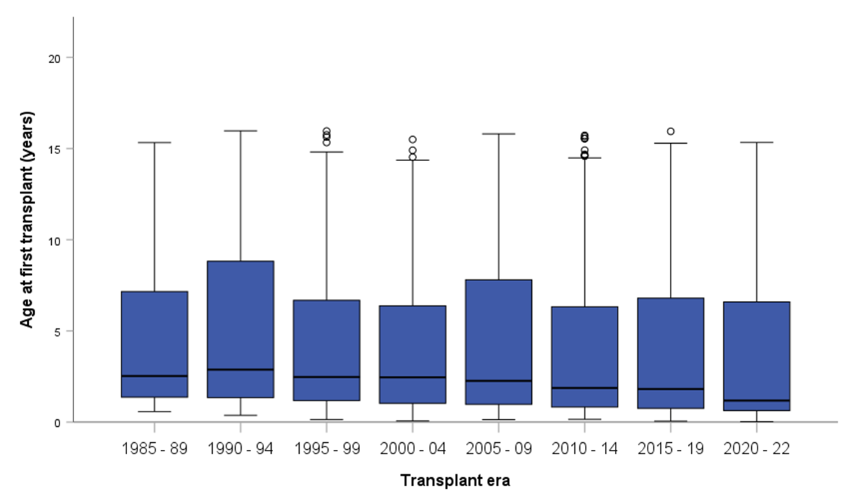
Paediatric age at first transplant by transplant era
Notes:
Figure 16. Paediatric age at first transplant by transplant era

Slide 27
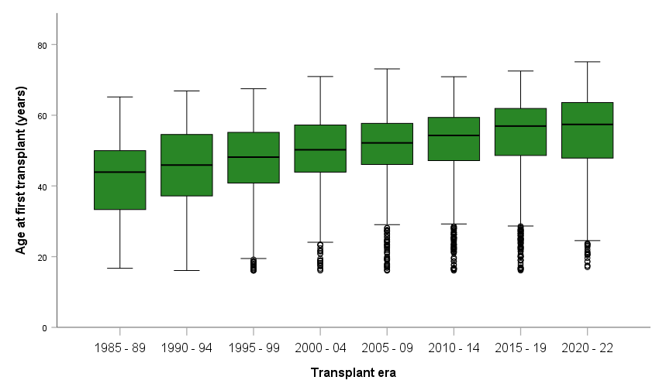
Adult age at first transplant by transplant era
Notes:
Adult age at first transplant by transplant era

Slide 28
Transplants by age group (1985 – 2022)
Transplants Transplanted in ANZ from 1985 to 2022 | Children (<16 years) | Adults (>=16 years) | Total
Number of transplants (% total transplants) | 1,291 (17.0%) | 6,289 (83.0%) | 7,580
Number of patients (% total patients) | 1,132 (16.2%) | 5,857 (83.8%) | 6,989
Notes:
Table 5. Transplants by age group (1985 – 2022)

Slide 29
Cumulative number of liver transplants per year by age category
Notes:
Figure 18. Cumulative number of liver transplants per year by age category

Slide 30
Number of liver transplants per year by recipient age category
Notes:
Figure 19. Number of liver transplants per year by recipient age category

Slide 31
Type of graft for paediatric recipients
Notes:
Figure 20. Type of graft for paediatric recipients – all years

Slide 32
Type of graft for adult recipients
Notes:
Figure 21. Type of graft for adult recipients – all years

Slide 33
Section 10. Diagnoses at First Transplant

Slide 34
Primary paediatric diagnosis
Notes:
Figure 22. Primary paediatric diagnosis

Slide 35
All paediatric diagnoses
Notes:
Figure 23. All paediatric diagnoses

Slide 36
Primary diagnosis trend in adults
Notes:
Figure 24. Primary diagnosis trend in adults

Slide 37
All diagnoses trend in adults
Notes:
Figure 25. All diagnoses trend in adults

